Slide 1
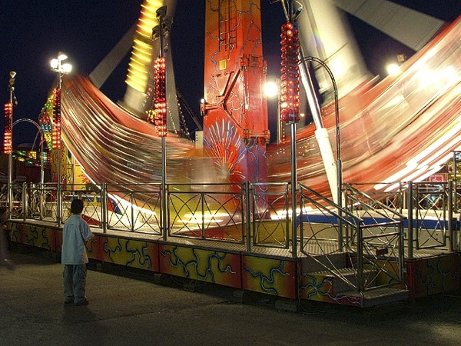
Speed and Velocity

Slide 2
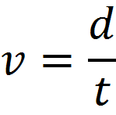
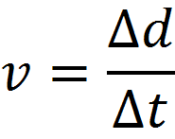
Speed (v): distance traveled in a given time
Speed is a scalar
Velocity (v): change of position over time
Velocity is a vector
Where Δ means “change in” or final – initial
Average speed
Average velocity

Slide 3
Ex:
A student travels 11 m north and then turns around and travels 25 m south. If the total time of travel is 12 s, find
The student’s average speed.
The student’s average velocity.

Slide 4
1) How long does it take a car traveling at 45km/h to travel 100.0 m?
2) How far does a skateboarder travel in 22 s if his average velocity is 12.0 m/s?
3) A shopping cart moves from a point 3.0 m West of a flagpole to a point 18.0 m East of the flagpole in 2.5 s. Find its average velocity.

Slide 5
So what happens if the speed or velocity isn’t that same the entire time?
What is it called?
Anyone?

Slide 6
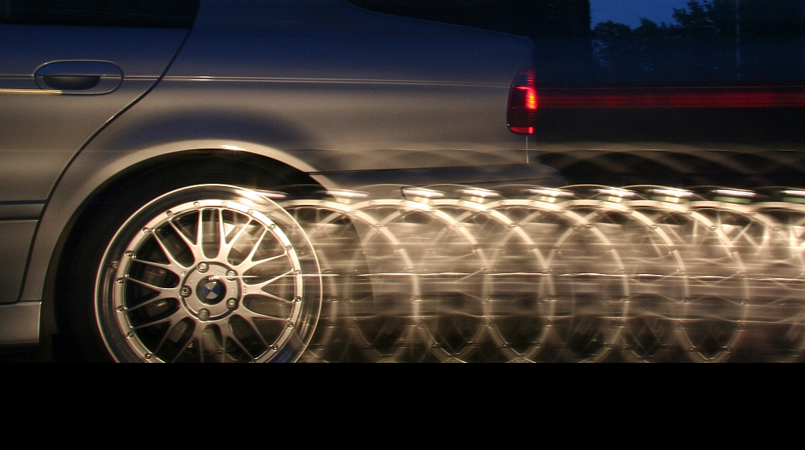
Uniform Accelerated Motion

Slide 7
Acceleration (a): the rate at which an object changes its velocity. Measured in m/s².
Acceleration is a vector.
Anytime an object’s velocity is changing (whether up or down) it is accelerating.

Slide 8
The acceleration of an object can be found with:
Where: a = acceleration
Δv = change in velocity
t = time
a = Δv
t

Slide 9
A sprinter starts from rest and reaches a speed of 12 m/s in 4.25 s. Find his acceleration.
A car starts from rest and accelerates at 15 m/s² for 3.0 s. What is its top speed?
If a snowboarder is traveling at 8.0 m/s how long will it take her to reach 36.0 m/s if she can accelerate at a rate of 3.5 m/s²

Slide 10
Remember that all vectors include a direction. In 1-D we assign them a sign.
Up or to the right are both positive
Down or to the left are both negative
An object’s velocity and acceleration can be in opposite directions.

Slide 11
Determine the direction of the velocity and acceleration
 | Velocity | Acceleration
A car sitting at a stop light hits the gas
From rest you back out of your driveway
A plane lands and comes to a stop
You drop a rock off a cliff
You throw a rock straight up

