Slide 1
Graphing Motion d vs. t and v vs. t

Slide 2
For d vs. t graphs:
Slope = rise = displacement = velocity
run time
For v vs. t graph:
Slope = rise = velocity = acceleration
run time
Area under graph = velocity x time = displacement

Slide 3
Imagine a car at a stop light. When the light turns green it accelerates forward at a constant rate.
Sketch d vs. t, v vs. t and a vs. t graphs of its motion.

Slide 4
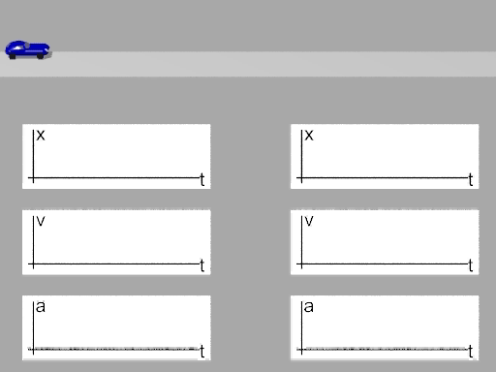

Slide 5
