Slide 1
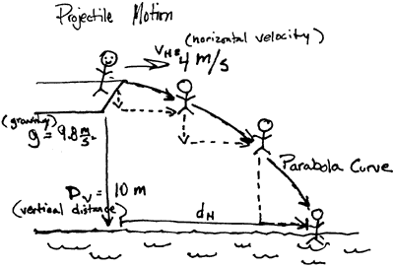
Projectile Motion

Slide 2
Projectiles in 2-D - x and y-components are perpendicular and therefore totally independent.
X-components
No net force in the x direction
Acceleration is always zero.
The only equation we can ever use is: v=d/t
Y-components
Always a constant acceleration of 9.80m/s² downwards.
Need to use the BIG 3 equations.
The only value that can ever be used on both sides is time because it is scalar and directionless

Slide 3
Ex 1: A student sits on the roof of their house which is 12 m high. She can launch water-balloons from a slingshot at 25 m/s. If she fires a water-balloon directly horizontally:
a. How long will it be airborne?
b. How far will it travel?
How long it is airborne only depends on:
Its initial velocity in the y-direction
How far it travels in the x-direction depends only on:
Its velocity in the x-direction and time

Slide 4
Ex 2: A quarterback launches a ball to his wide receiver by throwing it at 22.0 m/s at 35º above horizontal.
a. How far downfield is the receiver?
b. How high does the ball go?
c. At what other angle could the quarterback have thrown the ball and reached the same displacement?

Slide 5
Ex 3: A cannon sits on a 65 m high cliff (typical Trask…so typical…). A cannonball is fired at 42 m/s 55º above the horizontal.
a. How long is it airborne?
b. What is its final velocity?
c. What is its maximum height relative to the ground below?

