Slide 1
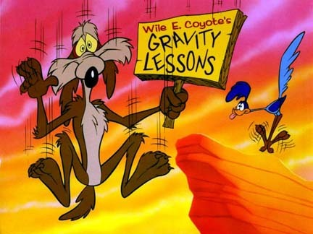
Acceleration Due to Gravity

Slide 2
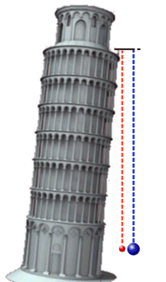
Acceleration Due to Gravity
In the absence of air friction all objects fall at the same rate, regardless of mass.
Near Earth’s surface the acceleration due to gravity is:
g = -9.80 m/s²

Slide 3
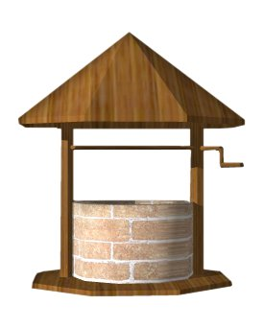
Ex.
A student drops their homework down a wishing well. After 2.4 s it hits the water at the bottom. How deep is the well?

Slide 4
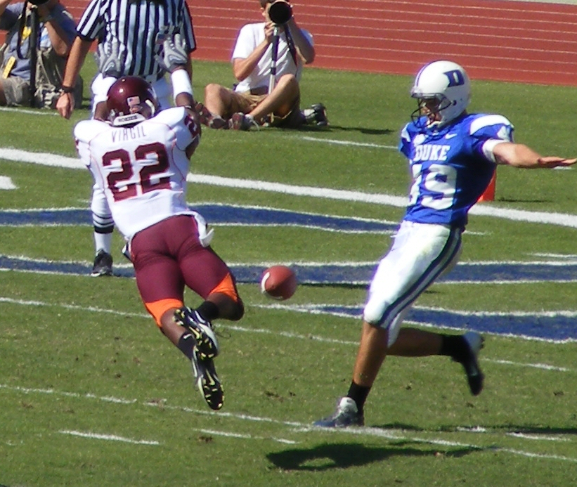
Ex.
A football is kicked straight up in the air at 15 m/s.
How high does it go?
What is its total hangtime?

